Slide 1

BANK MANAGEMENT SYSTEM
BY
SRINIVAS (186969)

Slide 2
TABLE OF CONTENTS
Database
Introduction to SQL
Introduction to PL/SQL
Objective
Abstract
Software Development Life Cycle
Software Requirements

Slide 3
TABLE OF CONTENTS (CONTD.)
Tables Used
UML Diagram
Entity Relationship Diagram
Coding
Testing
Test Cases
Real time implementation
Summary

Slide 4
Database
A database is an organized collection of data, so that it can be easily accessed and managed.
You can organize data into tables, rows, columns, and index to make it easier to find relevant information.
The main purpose of the database is to operate a large amount of information by storing, retrieving, and managing data.
There are many dynamic websites on the World Wide Web nowadays which are handled through databases. For example, a model that checks the availability of rooms in a hotel. It is an example of a dynamic website that uses a database.
There are many databases available like MySQL, Sybase, Oracle, MongoDB, Informix, PostgreSQL, SQL Server, etc.

Slide 5
Introduction to SQL
SQL stands for Structured Query Language. SQL is the language used to create, edit and manipulate a database. In other words, SQL is used to manage data held within a relational database management system (RDBMS).
Pronounced as SEQUEL, SQL was originally developed by IBM based on Dr. E.F. Codd’s relational model.
The main operations performed are DQL, DML, DDL, TCL, DCL.
SQL is just a query language; it is not a database. To perform SQL queries, you need to install any database, for example, Oracle, MySQL, MongoDB, PostGre SQL, SQL Server, DB2, etc.

Slide 6
Introduction to PL/SQL
PL/SQL is an extension of Structured Query Language (SQL) that is used in Oracle. Unlike SQL, PL/SQL allows the programmer to write code in a procedural format. Full form of PL/SQL is "Procedural Language extensions to SQL".
It combines the data manipulation power of SQL with the processing power of procedural language to create super powerful SQL queries.
It was developed by Oracle Corporation in the early 90's to enhance the capabilities of SQL.
PL/SQL is one of three key programming languages embedded in the Oracle Database, along with SQL itself and Java.

Slide 7
OBJECTIVE
Designing the database and preparing queries required for the banking management system.

Slide 8
Abstract
This banking database keeps track of details of all customers having account in various branches and the transactions made by them. This database also records the details of atm card details and internet banking details.

Slide 9
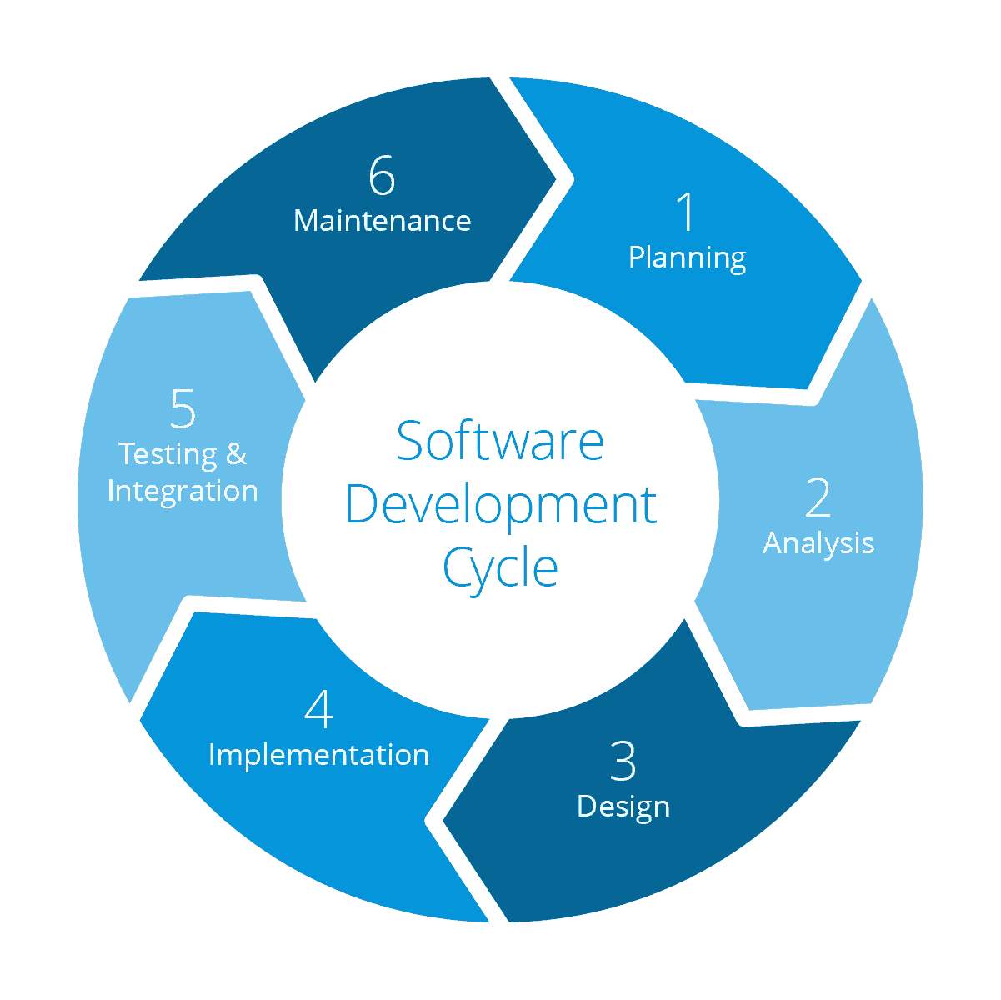
Software Development Life Cycle

Slide 10
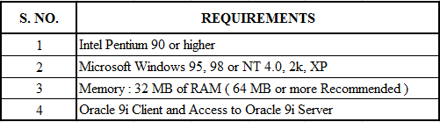
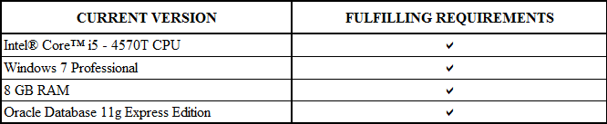
Software Requirements

Slide 11
Tables Used

Slide 12
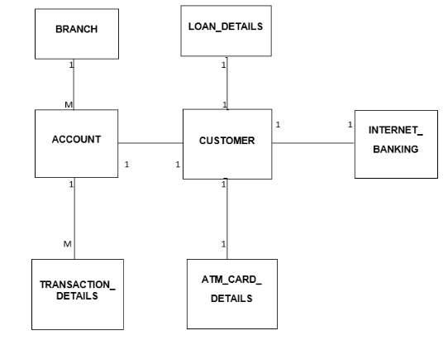
UML Diagram

Slide 13
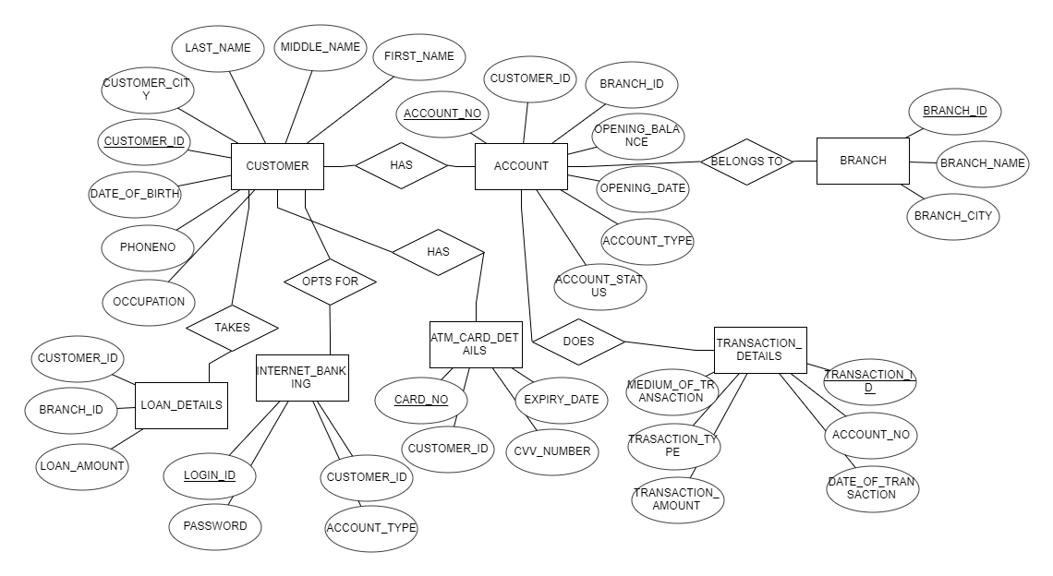
ER Diagram

Slide 14
Topics used for coding
S.NO | SUBJECT | TOPIC NAME
1 | SQL | DDL, DML, DCL, TCL, DQL
2 | SQL | JOINS & SUBQUERIES
3 | PL/SQL | PROCEDURES & FUNCTIONS
4 | PL/SQL | TRIGGERS
5 | PL/SQL | EXCEPTION HANDLING
6 | PL/SQL | CURSORS

Slide 15
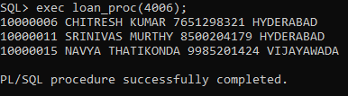
Coding
The process of designing, writing, testing, debugging / troubleshooting, and maintaining the source code of computer programs.
Query snapshots:
Write a procedure to take branch_id as parameter and retrieve details of the account_no, first_name, last_name, customer_city, phone_no and loan_amount of the customer who had taken loan from that branch.

Slide 16
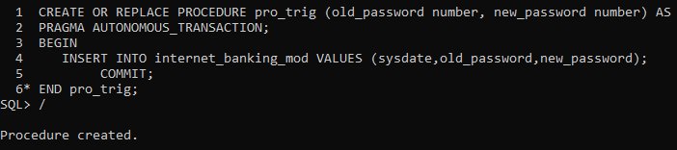
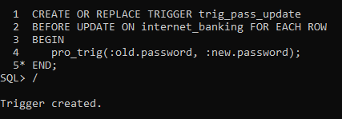
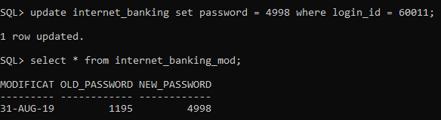
Coding (Contd)
Write a trigger to store the old password and the changed password of the internet_banking n the new table.

Slide 17
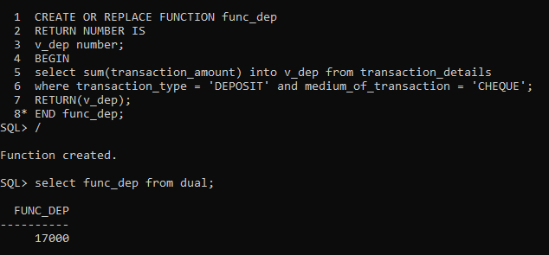

Coding (Contd)
Write a function to return the total amount deposited through cheque by all the customers.
Write a procedure to delete internet_banking record of the customers whose account_status is terminated or suspended by taking the customer_id as the parameter.

Slide 18
Testing
Software testing is defined as an activity to check whether the actual results match the expected results and to ensure that the software system is defect free.
Software testing also helps to identify errors, gaps or missing requirements in contrary to the actual requirements.
It can be either done manually or using automated tools.
Testing is important because software bugs could be expensive or even dangerous. Software bugs can potentially cause monetary loss to the organization.

Slide 19
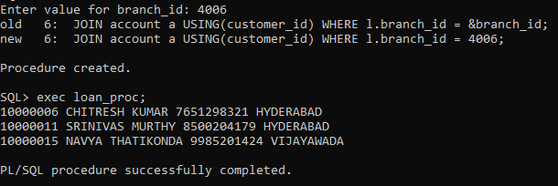
Test cases
Write a procedure to take branch_id as parameter and retrieve details of the account_no, first_name, last_name, customer_city, phone_no and loan_amount of the customer who had taken loan from that branch.

Slide 20


Test Cases (Contd)
Write a procedure to delete internet_banking record of the customers whose account_status is terminated or suspended by taking the customer_id as the parameter.
Before executing procedure
After executing procedure

Slide 21
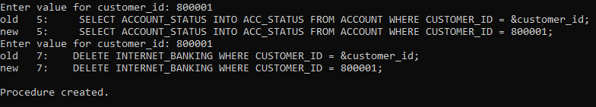

Test Cases (Contd)
This is the failed test case as the entered account is neither suspended nor terminated

Slide 22
Real time implementation
Customer accounts record
Easy implementation of data using PL/SQL
Organisations used - Banks
Storing of customer transactions.

Slide 23
Summary
A database system for BANK MANAGEMENT SYSTEM is built with needed functionalities.
This project is built with the following functionalities:
Creating tables
Inserting data into the database
Displays the details of the customers who had taken loan from a particular branch by using procedure
By using procedure deleted the records of the internet banking whose account status is either terminated or suspended
Created function to return the total amount deposited through cheque by all the customers.
Created trigger to store the changes made in the internet banking password in a new table

Slide 24
Thank You….

